Slide 1
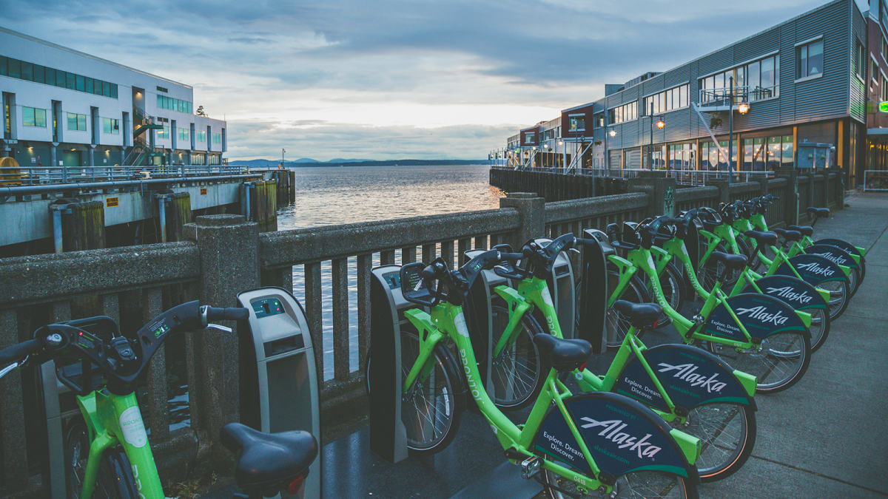
Bike Sharing in Seattle
Sam Beadles, Mier Chen, Katherine Qian, Zhiwei Zhang
Notes:
S

Slide 2
Agenda
Introduction, guiding questions
Description of data
Data Cleaning
Data Analysis
Findings
Notes:
S

Slide 3
Description of Data

Slide 4
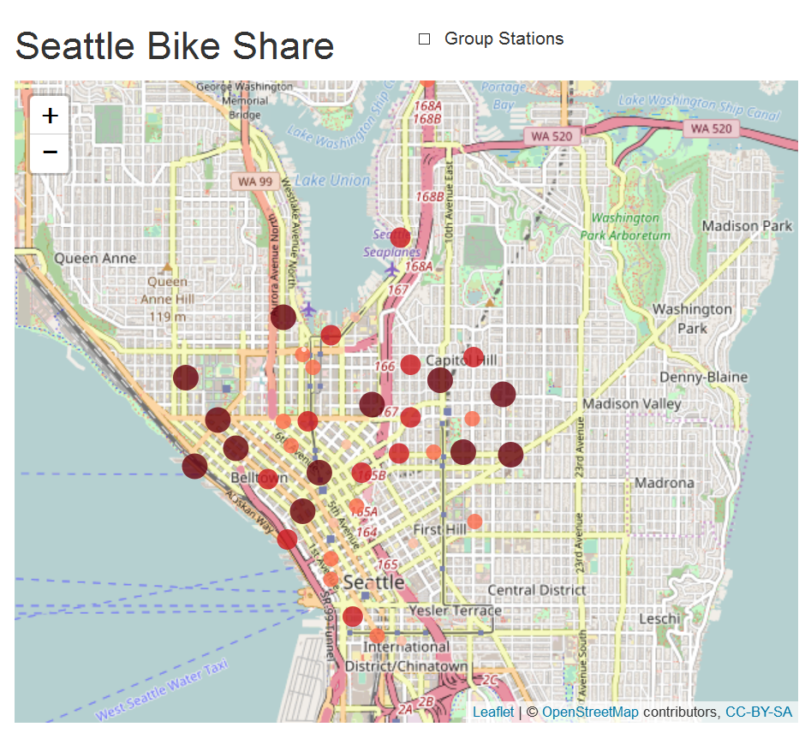
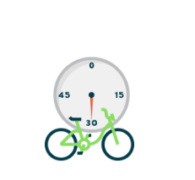
Our data is based on a bike sharing program in Seattle, WA
Pronto Bike Share Program:
Based in Seattle
Annual member vs short-term pass holders
30/45 minute fee structure
58 stations
500 bikes
Notes:
Short term members begin to pay after 30 minutes
Annual members start to pay after 45 minutes
Z

Slide 5

To do our analysis, we worked from 3 data sets
station.csv: [ “station_id” , “lat” , “long” , “name” ]
trip.csv: [ “starttime”,”stoptime”, “tripduration”, “from_station_id”, “to_station_id” , “usertype”, “birthyear” ]
weather.csv: [ “Max_Temp”, “Min_Temp” , “Max_Gust_Wind_Speed” , “Events” ]
Notes:
station and weather datasets were relatively small compared to trip
K

Slide 6

Glimpse of the data
In those 688 days,
There are 236,065 trips,
4,731,578 hours of riding,
With an average of 20 minutes per trip,
Done by 61.9% annual members
Notes:
Recorded data from mid-2014 to mid-2016
4.7 million riding time
S

Slide 7
Data Cleaning

Slide 8

We had to clean inside the data sets to make them usable
Check the accuracy of data: Duplicates in trip_id
Datetime format: “10/13/14 10:48” → “2014-10-13 10:48:00”
Create columns: “start_year”, “start_weekday” ,”age”,
Inconsistency in weather.Events: “Rain, Snow” → “Rain-Snow”
Buckets for temperatures
Station names:
Burke Museum / E Stevens Way NE & Memorial Way NE →
E Harrison St & Broadway Ave E
Notes:
1. Duplicates: ~50,000 with all the same fields - that checks for accuracy in the data sets
2. Cconverted to datetime format and then extracted relevant information by adding more columns by day, month that allowed for easier for analysis
Merged
M

Slide 9

Left merge on ‘starttime’ and “date”
trip_df + weather_df => trip_weather_df
trip_weather_df + from_station_df
+ to_station_df
=> cycle_df
Left merge on
“from_station” and “to_station”
Cycle_df
227954 rows and 65 columns

Slide 10
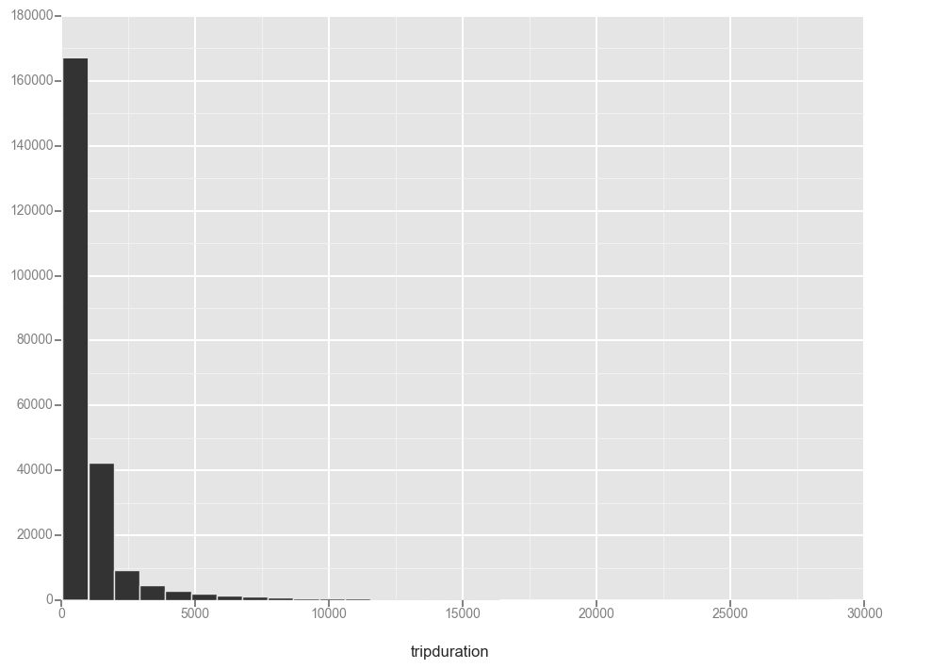
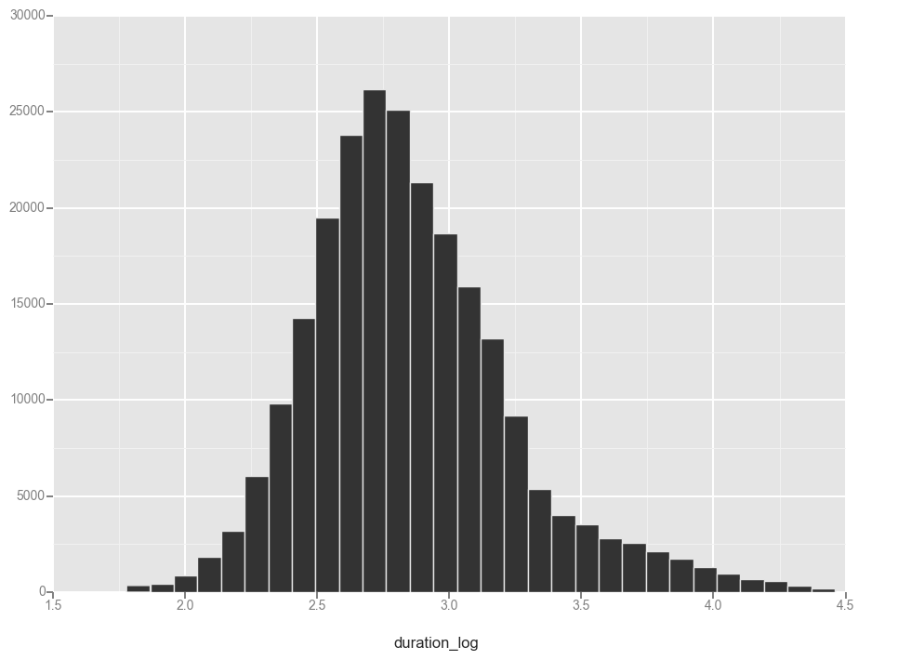
We eliminated outliers in the trip duration set
Notes:
Longest trip: 30,000 sec
Shortest: 60 sec
Log of differ observations, and took mid-50%, eliminating 1-2% of the data
S
Drop 8111 data, which is 3.5% of the data.

Slide 11
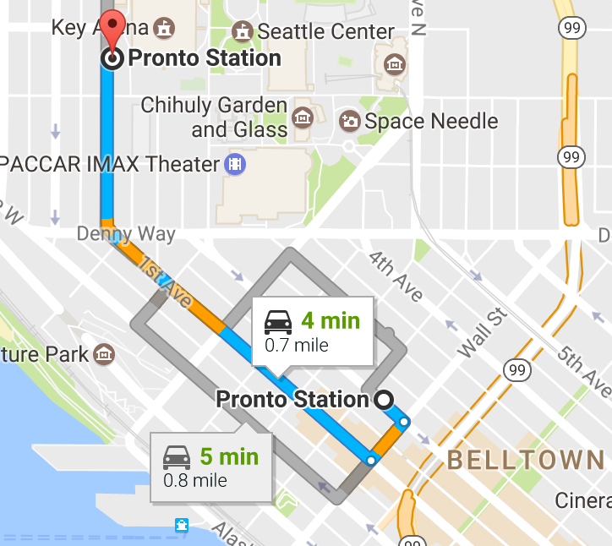
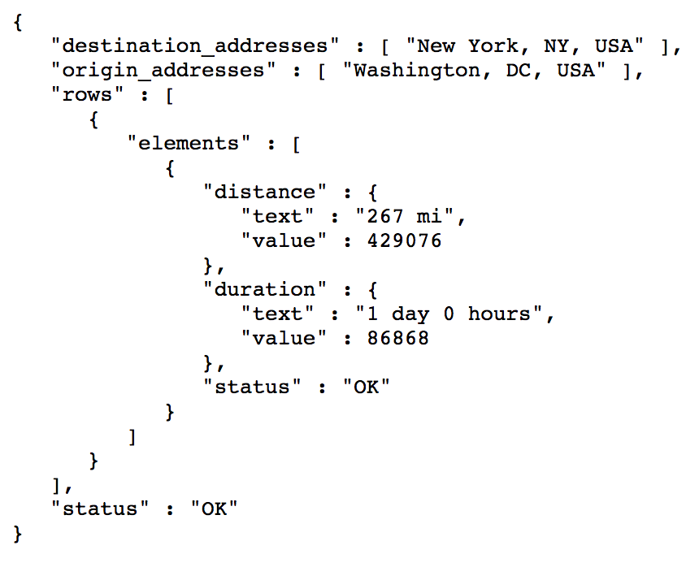
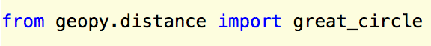
We developed two methods to calculate distance
Google API:
Notes:
Adding other information to the datasets
S

Slide 12
Data Analysis

Slide 13
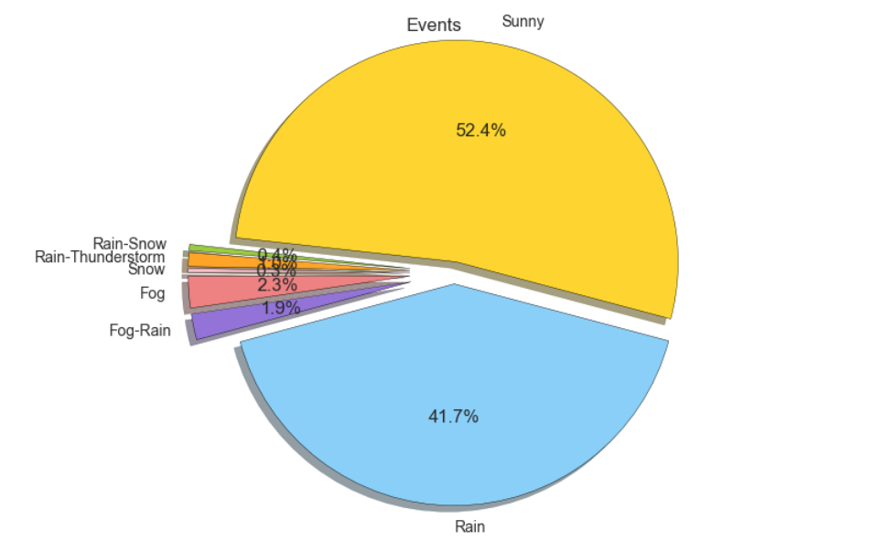
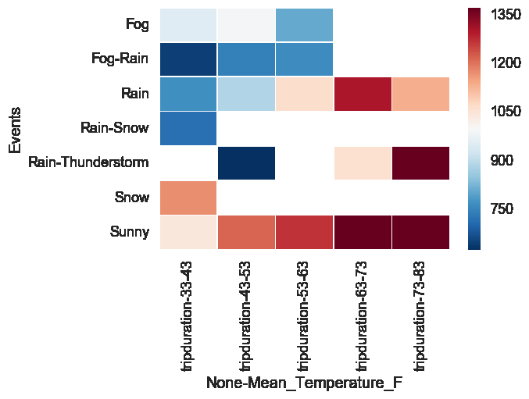
Weather events are biased toward rain, sun
Notes:
Not much data on weather conditions outside of sunny/rainy
Heat map: mean trip duration
Z

Slide 14
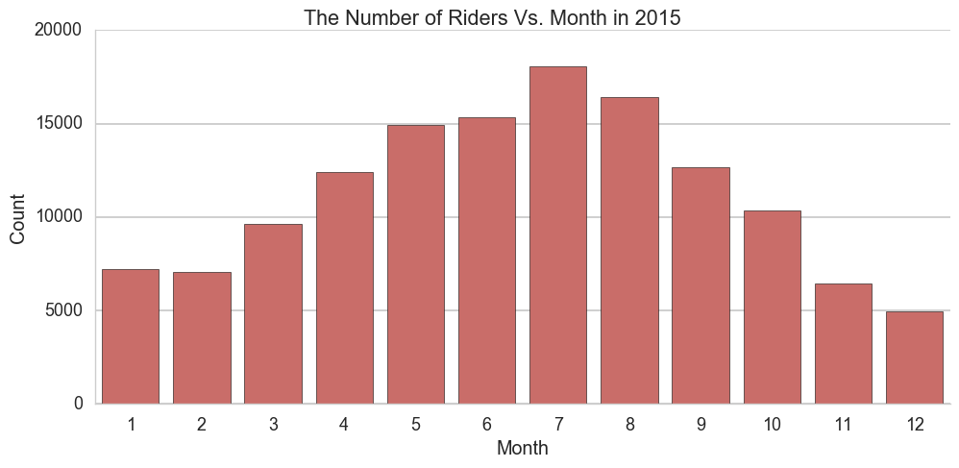
Ridership peaks in summer months of June, July
Notes:
K

Slide 15
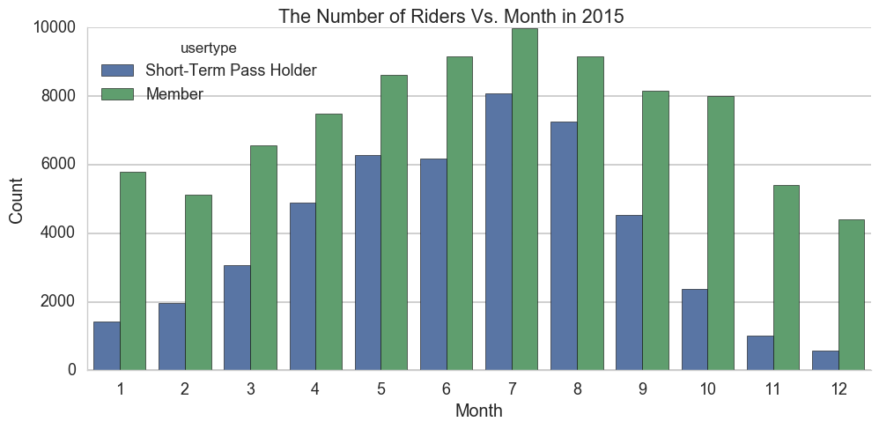
Pass holders have a much more pronounced preference for summer months
Notes:
S

Slide 16
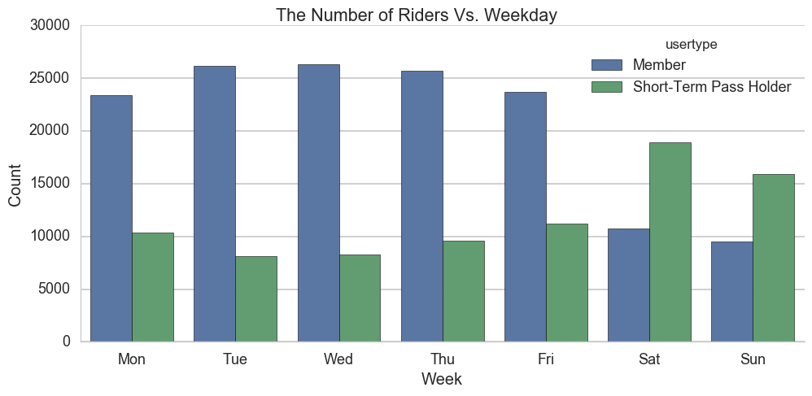
Rider demographics depend on day of the week
Notes:
M
During the weekday, we have much more members than the short term pass holders.
However, during the weekend, the number of members drop dramatically, and the number of short term pass holders increase.

Slide 17
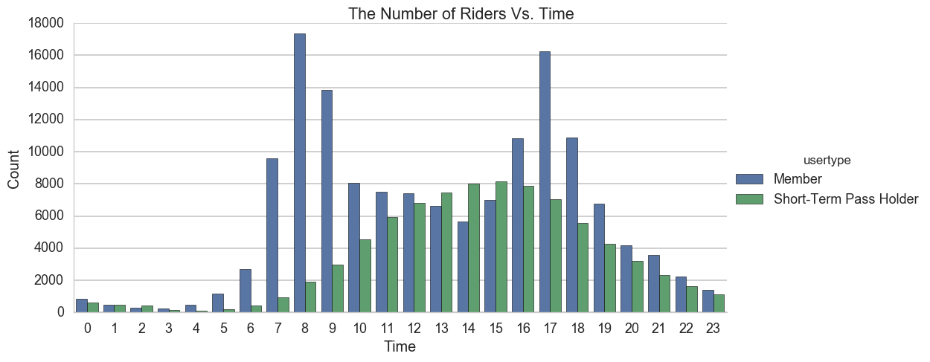
Rider demographics depend on time

Slide 18
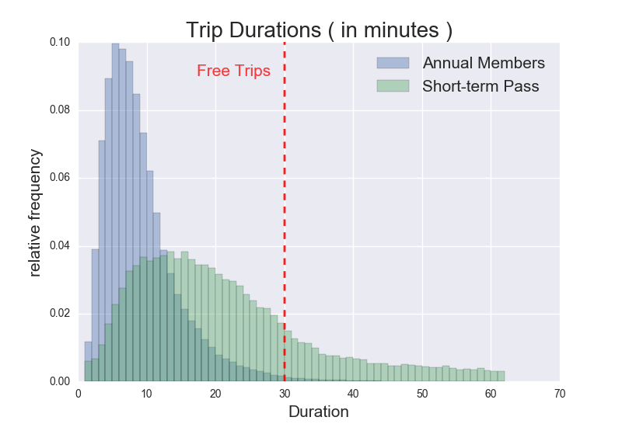
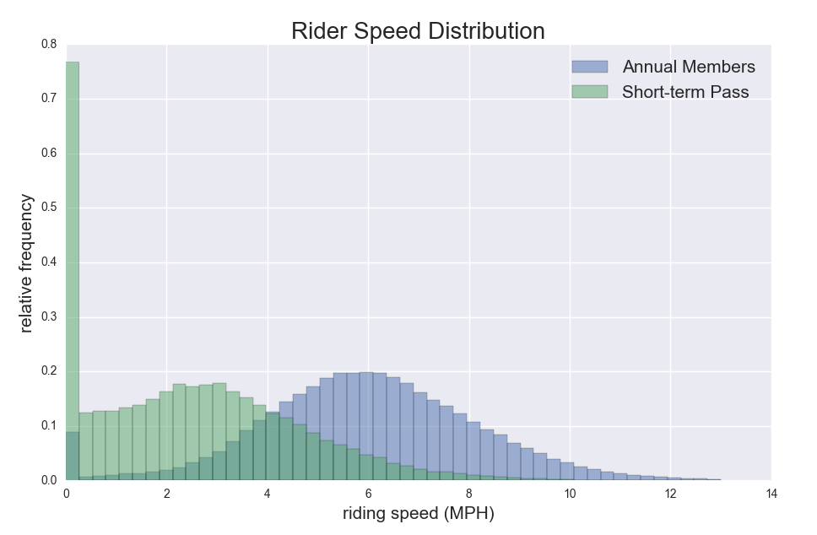
Pass holders are chronic tour-ers
Notes:
Long term mean: 9.8 min
Short term mean: 26.5 min; 12.6% went over 30 min
5.9 MPH vs 2.5 MPH,
S

Slide 19
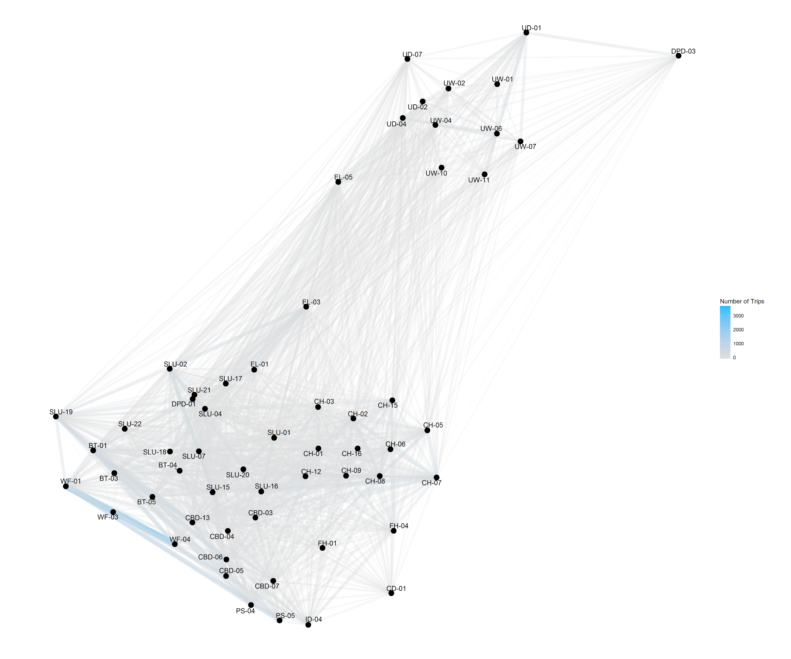
Downtown Seattle is a more popular route than the University
UW, Seattle
Downtown Seattle
Notes:
In order to get a better look into the distribution of stations and the popularity of routes, we made this map.
We can clearly identify the popular routes are mostly in the downtown Seattle area. The most popular ones are in blue.
Before making the map, we thought the university students use the bike share very often….
Most are in downtown seattle
M

Slide 20
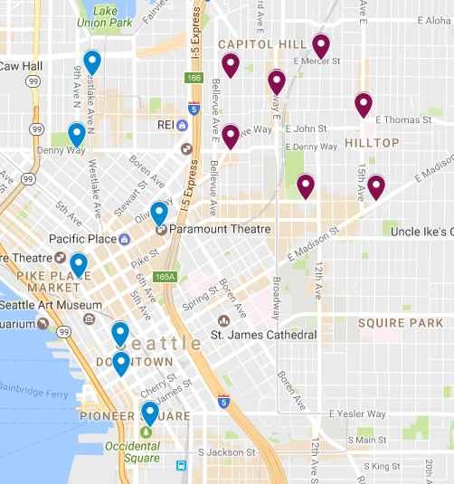
Bikes are unevenly picked up and dropped off across Seattle
Notes:
Net score for each statiom
K
M: The popularity map is kind of messy. I wanna know more information about the station and the environment around them. Hence, I made this interactive map.
The size and color of the dots represent the popularity of that station.

Slide 21
Pronto bikes may be able to capitalize on biker demographics
Charging fees before 30 minutes
Low elasticity? Competitors?
Concentrate upkeep, infrastructure on summer months
Change pricing structures for pass holders on weekends
Encourage more even distribution of bikes across Seattle: plan more regular bike transfers from highly-used to less-used.
Target Washington University students
Notes:
S

Slide 22
Questions?
Notes:
S

